Slide 1
CIS CONTROL 10: DATA RECOVERY CAPABILITIES
CIS 20 Critical Security Controls

Slide 2
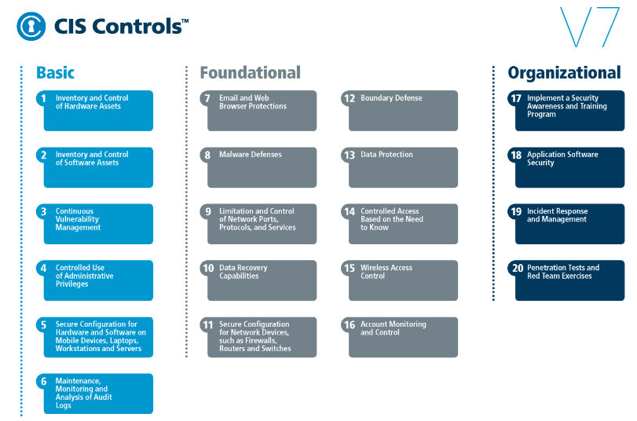
CIS CONTROL 10: DATA RECOVERY CAPABILITIES
https://www.cisecurity.org/controls/

Slide 3
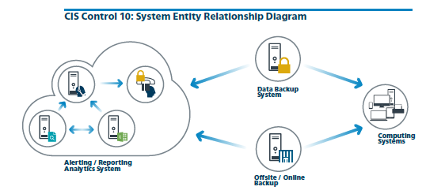
CIS CONTROL 10: DATA RECOVERY CAPABILITIES
https://www.cisecurity.org/controls/

Slide 4
CIS CONTROL 10: DATA RECOVERY CAPABILITIES
10.1: Ensure Regular Automated Back Ups
Ensure that all system data is automatically backed up on regular basis.

Slide 5
CIS CONTROL 10: DATA RECOVERY CAPABILITIES
10.2: Perform Complete System Backups
Ensure that each of the organization's key systems are backed up as a complete system, through processes such as imaging, to enable the quick recovery of an entire system.

Slide 6
CIS CONTROL 10: DATA RECOVERY CAPABILITIES
10.3: Test Data on Backup Media
Test data integrity on backup media on a regular basis by performing a data restoration process to ensure that the backup is properly working.

Slide 7
CIS CONTROL 10: DATA RECOVERY CAPABILITIES
10.4: Ensure Protection of Backups
Ensure that backups are properly protected via physical security or encryption when they are stored, as well as when they are moved across the network. This includes remote backups and cloud services.

Slide 8
CIS CONTROL 10: DATA RECOVERY CAPABILITIES
10.5: Ensure Backups Have At least One Non-Continuously Addressable Destination
Ensure that all backups have at least one backup destination that is not continuously addressable through operating system calls.

Slide 9
CIS CONTROL 10: DATA RECOVERY CAPABILITIES
Procedures & Tools:
Once per quarter (or whenever new backup equipment is purchased), a testing team should evaluate a random sample of system backups by attempting to restore them on a test bed environment. The restored systems should

Slide 10
CIS CONTROL 10: DATA RECOVERY CAPABILITIES
…be verified to ensure that the operating system, application, and data from the backup are all intact and functional.
In the event of malware infection, restoration procedures should use a version of the backup that is believed to predate the original infection.
END

